Slide 1
Employee data analysis using excel
Student name: J.Nithyalakshmi
Register number: 312214926
Department: B.com General
College: Annai veilakanni's college for women

Slide 2
PROJECT TITLE
Employee Performance Analysis using excel

Slide 3
AGENDA
1.Problem statement
2.Project overview
3.End user
4.Our solution and proposition
5.Datasey description
6.Modelling approach
7.Results and discussion
8.Conclusion

Slide 4
PROBLEM STATEMENT
A company wants to upgrade their manual employees management system.
In the current employee management system of, admin user.
Admin validate the details of the employee and then enters manually in an excel file

Slide 5
PROJECT OVERVIEW
1.The objective of this project is to provide a comprehensive approach towards the management of employees information
2.Provides full functional reports to the management of company
3.This project aims to simplify the task of maintaining records of the employee of company

Slide 6
WHO ARE THE END USERS
1.Employees
2.HR Business Partner
3.Manager
4.Employee Development Team
5.Talent Acquisition Team
6.Business Analysis

Slide 7

OUR SOLUTION AND PROPOSITION
Attract top talent
Reduce employee turnover
Reduce hiring cost
Strong company culture
Employee engagement

Slide 8
DATA SET DESCRIPTION
Description: This data set contains information on employee performance
Fields:
1.Name
2.Gender
3.Salaries
4.Employee ID
5.Department

Slide 9
THE WOW IN OUR SOLUTION
1.Attraction
2.Onboarding
3.Development
4.Employee engagement
5.Employee retention

Slide 10
MODELLING APPROACH
1.Employees
2.Predictive modeling
3.Network analysis
4.Bayesian network
5.Feature selection

Slide 11
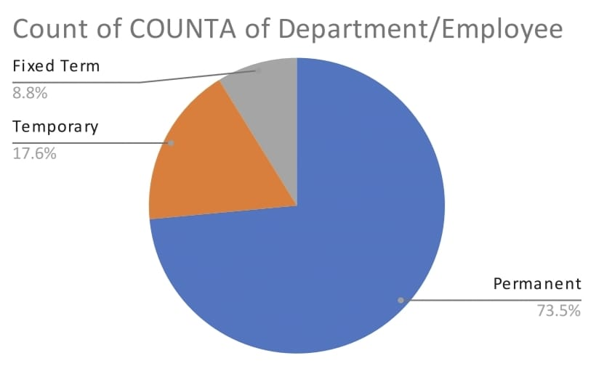
RESULTS

Slide 12
Conclusion
We need employee management system because we can able to search into different employees details using their I'd within seconds enabling organization to make data driven decisions

Slide 13


